Slide 1
Cicruit breaker

Slide 2
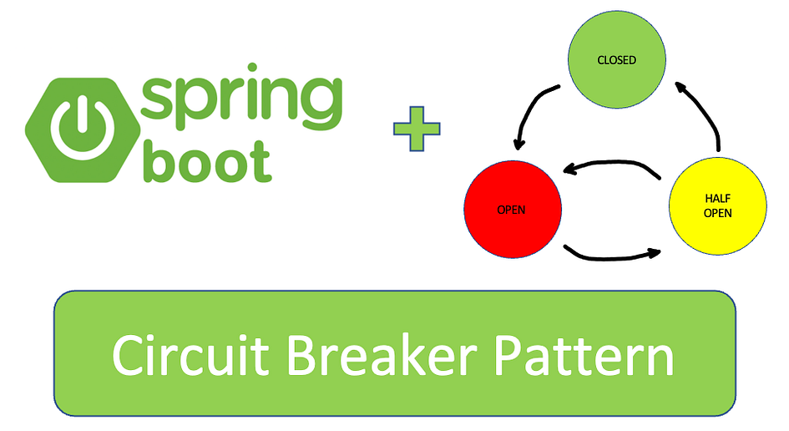
Circuit Breaker has three states: Closed, Open, and Half_Open.

Slide 3
pattern is to prevent calling a microservice in case of abnormal behavior in that service (service down or timeout…).
This idea can help the client’s side ignore handling failed requests and give the service some time to recover.

Slide 4
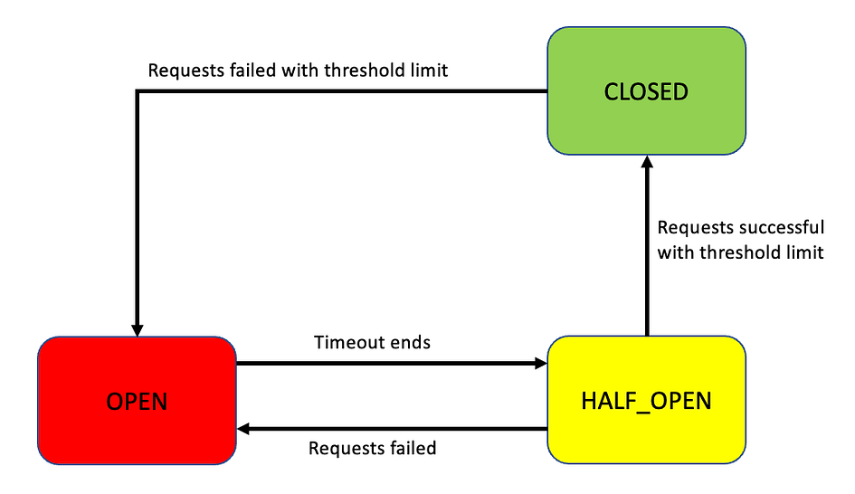

Slide 5
resilience4j-circuitbreaker configurations.
Resilience4j is a lightweight, fault-tolerance library designed specifically for Java applications.
It provides various resilience patterns, including circuit breakers, rate limiters, retries, timeouts, and bulkheads.
Resilience4j was created as a more modular, flexible alternative to Netflix’s Hystrix, allowing developers to select and configure only the resilience mechanisms they need.

Slide 6
sliding-window-type: The number of requests is recorded and aggregated in the last “sliding-window-size” seconds.
failure-rate-threshold: Trigger Circuit Breaker if at least “failure-rate-threshold” of requests have failed.
minimum-number-of-calls: Records at least “minimum-number-of-calls” requests in the last “sliding-window-size” seconds before calculating the failure rate.

Slide 7
automatic-transition-from-open-to-half-open-enabled: After ”wait-duration-in-open-state” seconds, Circuit Breaker will automatically transition from open to half-open state.
wait-duration-in-open-state: If triggered, wait at least “wait-duration-in-open-state” seconds before allowing more calls.
permitted-number-of-calls-in-half-open-state: After “wait-duration-in-open-state” time has passed, allow another “permitted-number-of-calls-in-half-open-state” requests and wait for them to calculate the failure rate again.
sliding-window-size: Record the result of the last “sliding-window-size” seconds.

Slide 8
Add dependency in productorder
<dependency>
<groupId>org.springframework.boot</groupId>
<artifactId>spring-boot-starter-actuator</artifactId>
</dependency>
<dependency>
<groupId>io.github.resilience4j</groupId>
<artifactId>resilience4j-spring-boot3</artifactId>
</dependency>

Slide 9
start eureka-server, product, api-gatey, configserver from microservice

Slide 10
Add values in productorder application.yml
resilience4j:
circuitbreaker:
instances:
PRODUCT:
sliding-window-type: COUNT_BASED
failure-rate-threshold: 50
minimum-number-of-calls: 5
automatic-transition-from-open-to-half-open-enabled: true
wait-duration-in-open-state: 5s
permitted-number-of-calls-in-half-open-state: 3
sliding-window-size: 10
register-health-indicator: true
server:
port: 5050
spring:
application:
name: product-feign-client
management:
endpoint:
health:
show-details: always
endpoints:
web:
base-path: /actuator
exposure:
include:
- health
- circuitbreaker
health:
circuitbreakers:
enabled: true

Slide 11
Implement Circuit Breaker: We’ll apply the circuit breaker on the getUserData method and include a fallback method for graceful degradation.
@CircuitBreaker(name = " PRODUCT ", fallbackMethod = "fallbackProductData") wraps the getUserData method with a circuit breaker.
name = " PRODUCT " links to the configuration for this circuit breaker in the application.yml file.
fallbackProductData provides a default response if the circuit is open or an error occurs, allowing the application to continue running smoothly.

Slide 12
@Service
//@ComponentScan(value="com.example.feign")
public class ProductOrderService1 {
@Autowired
ProductFeign productFeign;
public ResponseEntity<List<ProductDTO>> getAllProducts() {
try {
return productFeign.getAllProducts();
} catch (Exception e) {
return new ResponseEntity(e.getMessage(), HttpStatus.NOT_FOUND);
}
}
@CircuitBreaker(name = "PRODUCT", fallbackMethod = "fallbackProductData")
public ResponseEntity<ProductDTO> getProductById(int id) {
return productFeign.getProductById(id);
}
public ResponseEntity<ProductDTO> fallbackProductData(Throwable t) {
System.out.println("Fallback triggered for callExternalService: " + t.getMessage());
return new ResponseEntity("Product service is not responding properly",HttpStatus.NOT_FOUND);
}

Slide 13
Working with circuit breaker
Start application productorder
Check http://localhost:5050/productorder/52
Check localhost:5050/actuator/health
it will show product{
"state":closed
}

Slide 14
now stop product
then
call http://localhost:5050/productorder/52 API 3 times ,
then refresh the actuator link localhost:5050/actuator/health
now Circuit Breaker was triggered.
the reason is that failureRate is now greater than failure-rate-threshold.

Slide 15
Wait for 5 seconds, refresh the actuator link localhost:5050/actuator/health, and well see Circuit
Breaker now is in HALF_OPEN state.
During HALF_OPEN state, it allows permitted-number-of-calls-in-half-open-state requests (We configured its value
as 3).
then calculates the failure rate again, If the failure rate is still greater than failure-rate-threshold,Circuit Breaker will be triggered again. Continue calling order-service API 3 time
http://localhost:5050/productorder/52, then refresh the actuator link localhost:5050/actuator/health
"status": "CIRCUIT_OPEN", // // CircuitBreaker is triggered again
"state": "OPEN"

Slide 16
Now run product, then continue calling productorder API 3 times
http://localhost:5050/productorder/52
, refresh the actuator link
localhost:5050/actuator/health.
See Circuit Breaker was closed.

